Slide 1
Clinical Electrocardiography:
Objectives
Describe the waves of the electrocardiogram.
Describe the way the electrocardiogram is recorded
To relate heart electrical activity to an electrocardiogram tracing.

Slide 2
Electrocardiography:
The science which deals with the recording, analysis & interpretation of the electrical activity of the heart
The body fluid are good conductor of electricity therefore the electrical activity occurring in the heart during each beat can be picked up by the surface electrodes
2

Slide 3
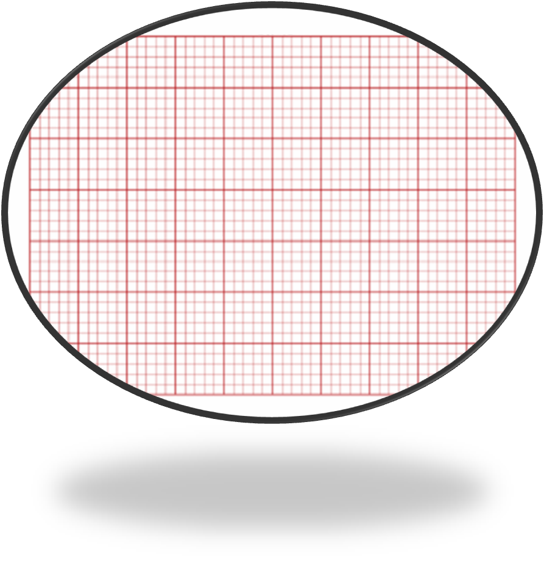
Normal electrocardiogram:
R
Q
p
First -ve deflection
after P wave
T
p
R
QRS
First +ve deflection
after P wave
Q
S
S
First -ve deflection after R wave
T
Vent. repolarization
Atrial depolarization
Vent. depolarization
S T segment
P R segment
P R interval
QT interval
3
3

Slide 4
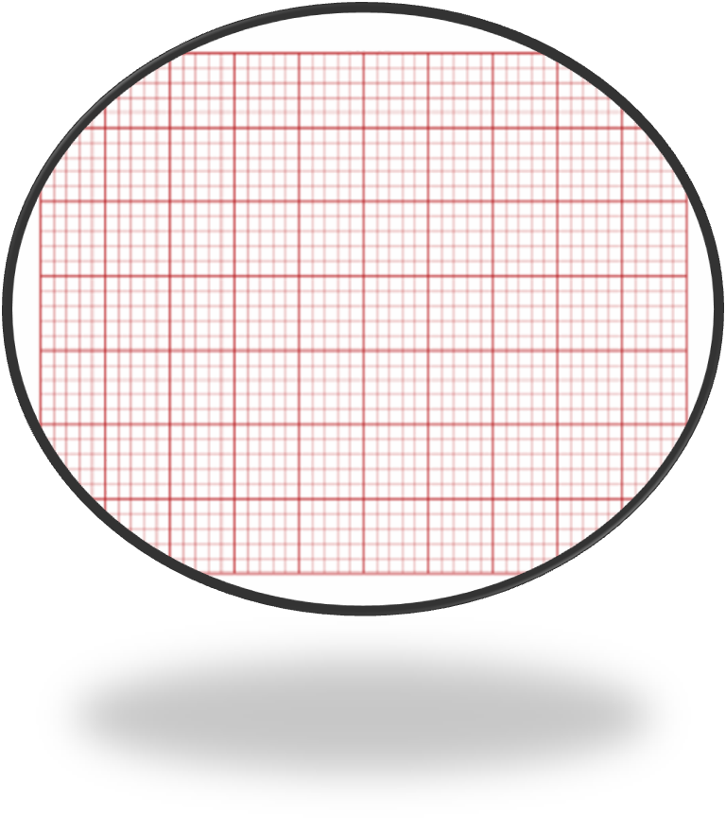
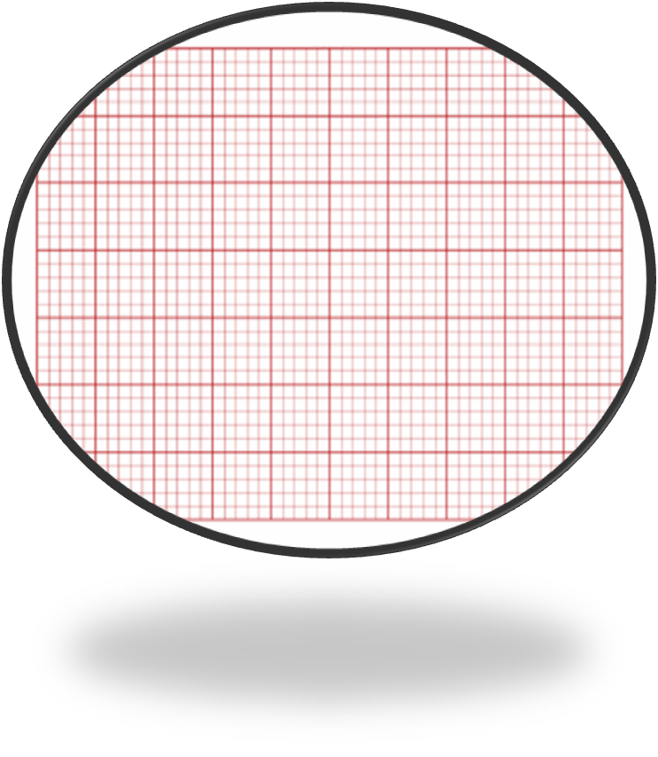
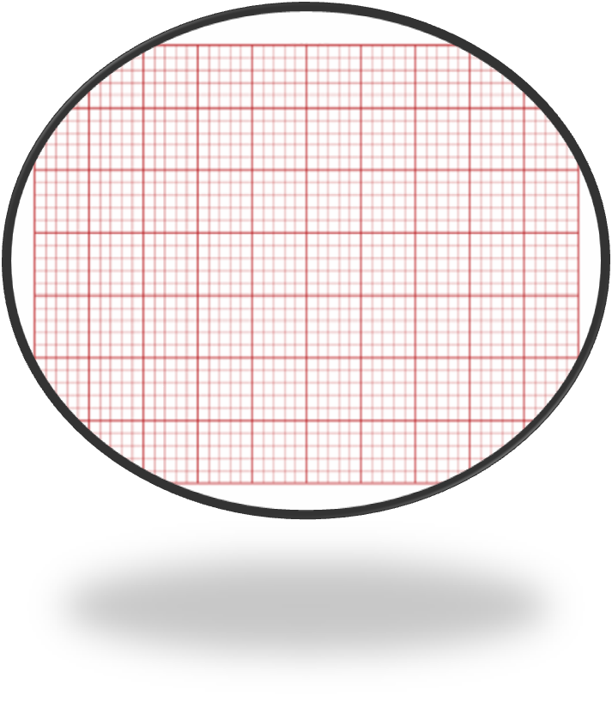
R
R
p
T
T
p
Q
p
R
T
S
S
4

Slide 5
Phase 0 &1 correspond to the R&S waves
phase 2 corresponds to ST segment
phase 3 corresponds to T wave on the ECG.
5

Slide 7
Q:
Atrial depolarization→ P wave (one deflection).
Vent. depolarization. → QRS complex ( many deflections)
WHY?
Because of the presence of different currents during ventricular depolarization
7

Slide 8
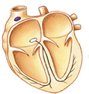
Electrical Conduction in Heart
R
p
T
Q
S

Slide 9
conduction velocity
S.A. &A.V. nodes 0.05m/sec
Atria, ventricles Internodal& His bundle 1m/sec
Purkinje fibers 4m/sec
9

Slide 10
Calibration of time and voltage on electrocardiogram paper:
1 small square = 0.04 sec
5 mm
1 mm
1/5 sec =0.2 sec
0.2/5 sec =0.04 sec
1 LS
1 SS
voltage
1 Large square = 5 mm
1 small square = 1 mm
5 LS
1 sec
1 Large square = 5 small squares
Speed = 25 mm/sec
Time
10

Slide 11
By another way:
Speed 25 mm / sec
25 mm
=
1 sec
1 mm
=
x
1 × 1
25
=
0.04 sec
x
=
11

Slide 12
0.1 mV
1 ss = 0.1 mV
voltage
1 mV = 10 ss
1 ss = 0.1 mV
1 ss = 0.04 sec
Time
12

Slide 13
Why we study these numbers:
13

Slide 14
To calculate the amplitude of the waves and
the duration of intervals.
Calculate :
3. The amplitude of R wave
2. The duration of QT interval
1. The duration of PR interval
= 6 × 0.04 Sec
= 7 × 0.1 mV
= 5 × 0.04 Sec
R
= 0.7 mV
= 0.2 Sec
= 0.24 Sec
7 ss
T
p
Normal PR interval = 0.12 – 0.2 sec
Q
5ss
S
Normal QT interval = 0.40 – 0.43 sec
6 ss
14
14

Slide 15
15

Slide 17
Before using the electrocardiograph, the usual voltage calibration is that:
(A) 1 mv signal produces 0.1 mm defection.
(B) 100 mv signal produces 10 mm defection.
(C) 10 mv signal produces 10 mm defection.
(D) 1 mv signal produces 10 mm defection.
(E) 1 mv signal produces 100 mm defection

Slide 18
The P-R interval of ECG:
(A) is the interval from the beginning of P wave to the beginning of T waves.
(B) has a duration that varies from 0.25 to 0.3 second.
(C) Is affected by the conductivity of AV node.
(D) all of the above.
(E) non of the above

Slide 19
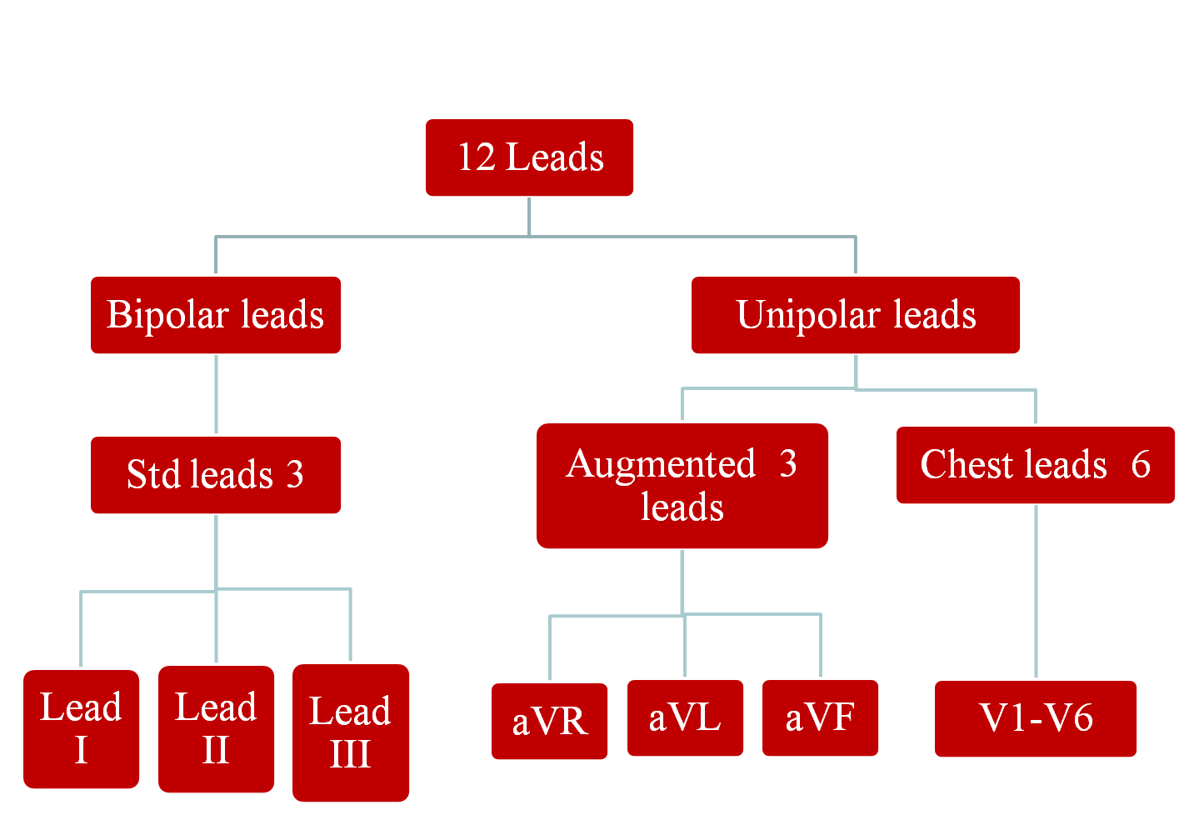
Electrocardiogram leads:
19

Slide 20
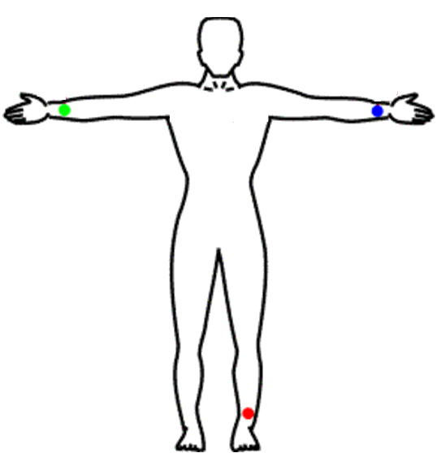
Bipolar leads:
Lead I
I
180˚
I
II
III
III
II
Lead III
Lead II
20

Slide 21
Unipolar leads:
Augmented limb leads
aVR
aVL
aVF
21

Slide 22
Unipolar leads:
Chest leads
22

Slide 23
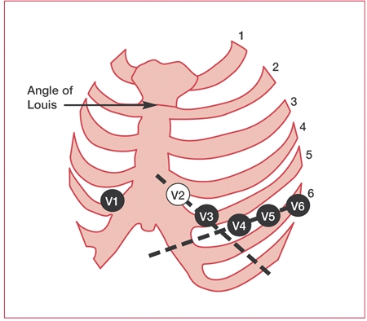
23

Slide 24
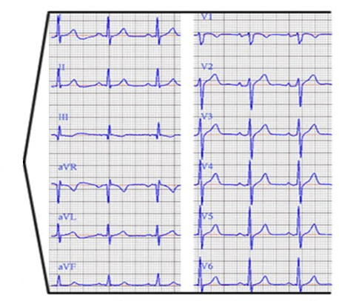
29

Slide 25
Electrocardiogram leads can be
30

Slide 26
Electrical Conduction in Heart

Slide 27
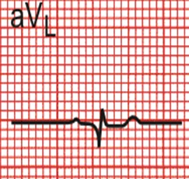
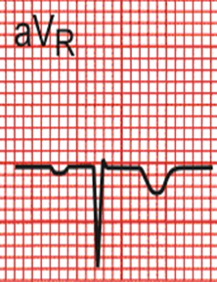
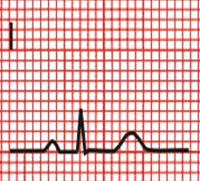
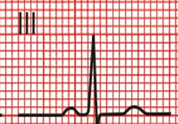
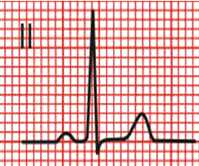
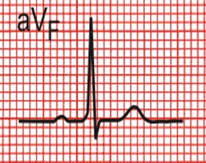
34

Slide 28
Electrical Conduction in Heart
aVR
R
p
T
R
S
p
T
Q wave appear at (V4- V6 ).
Q
S
V4

Slide 29
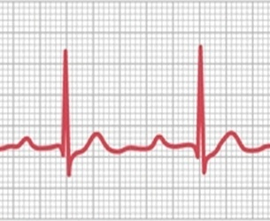
Calculation of the HR
A . Regular HR
R
1 2 3 4
5
R
5 10 15 20
25
HR= 60
HR= 300
R-R interval
× 0.04
R-R interval
No. of LS
= 60 BPM
36

Slide 30
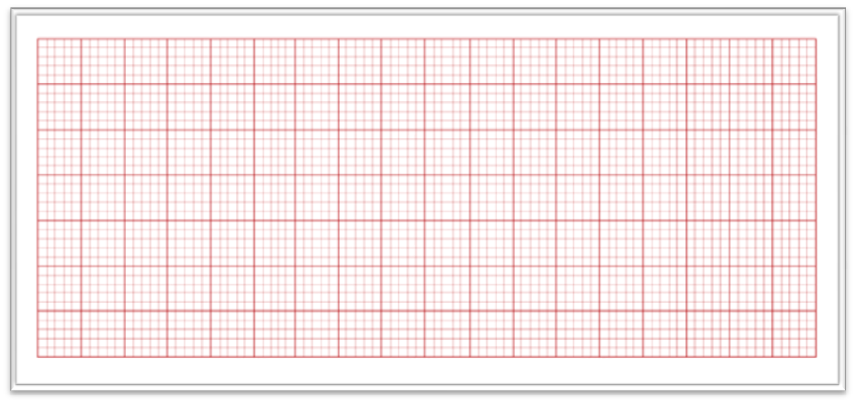
B. Irregular HR
HR = No. of R waves in 15 LS × 20
= 4 × 20
= 80 bpm
1 2 3 4 5 6 7 8 9 10 11 12 13 14 15
1 2 3 4
37

Slide 31
The clinical uses of ECG: Arrhythmias as an example
Arrhythmias:
H.R.= 60-90 beats / min. (normal sinus rhythm)
any change in this rate or rhythm or both is called arrhythmias
38

Slide 32
There are 2 types of arrhythmias:
a. Physiological :
1. Tachycardia (H.R. ˃ 100 beats / min.)
example: sympathetic stimulation (exercise)& fever.
39

Slide 33
2. Bradycardia (H.R. ˂ 60 beats / min.)
example: Parasympathetic stimulation (sleep) &athletes
40

Slide 34
3 . Sinus arrhythmia:
The H. R. increases with inspiration & decreases with expiration.
expiration
inspiration
expiration
41
41

Slide 35
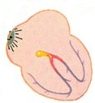
Medulla oblongata
CIC
vagus
lung
Strech receptors
heart
42

